Slide 1


Enable System Team:
Tania Peña Santana
Yanilette López Duprey
Victor Rivera Díaz
Nilka Quiles González
Jonathan Meléndez Brady

Slide 2
SRS
Problem
Scope
Future Features
Interfaces
Logical Database Requirements
User Cases
User Characteristics
Constraints
Software Systems Attribute
Assumptions and Dependencies

Slide 3

Problem GS DBMS
Customer Lookup divides employees in two groups: Managers & Regular Employees
Delay in current system when monitoring Company Inventory
Antiquated system relies on Store-to-Store calls for holding games for the customer.
When an item can not be found, there is no way to have it delivered to the store.
Jonathan

Slide 4
Scope
Objectives
Eliminates the delays.
Repairs the erroneous or outdated information that the current program presents in the stores
The Goal :
The ESILGS Increases the sales by improving the Item Look up Program.
Improves
The ESILGS improves the search in the item data base locally and externally in each store and between them of all GameStop stores throughout Puerto Rico and The United States.
The program provides the same information to the regular employee as the manager in the ESILGS.
The ESILGS repairs the erroneous or outdated information that the current program presents in the stores
Victor

Slide 5
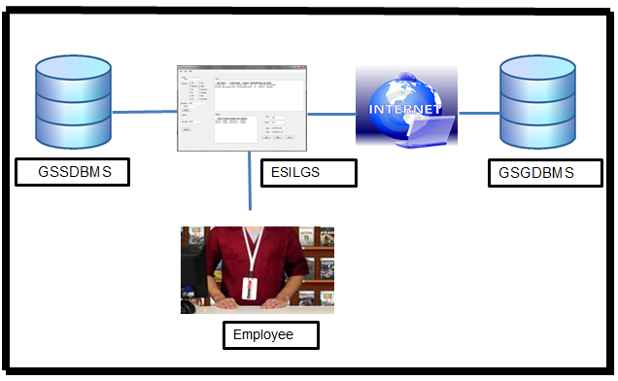
System Interfaces
ESILGS Interface
Victor

Slide 6
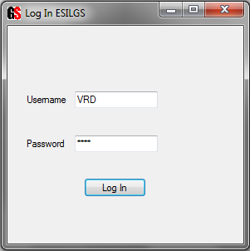
User interfaces
Login Interface
Victor

Slide 7
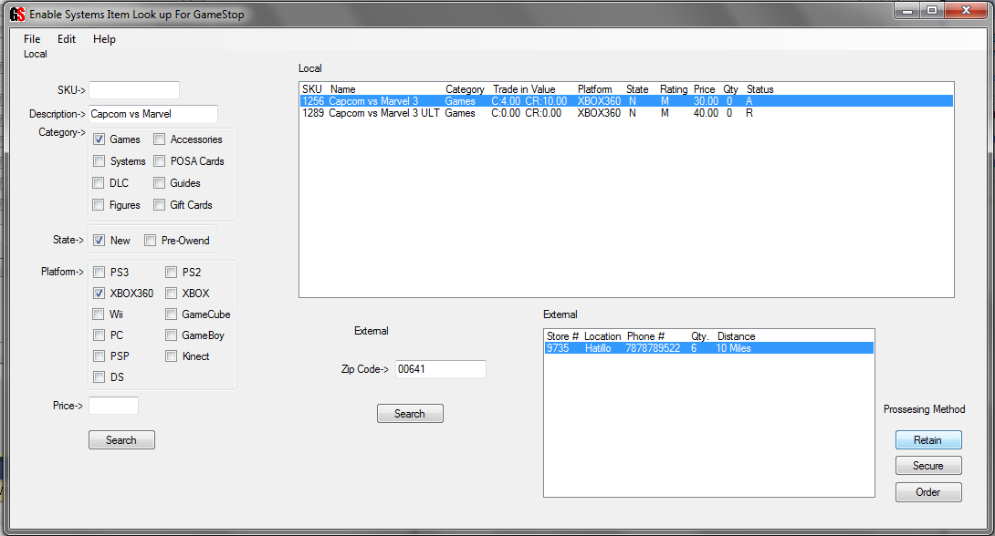
User Interfaces
Local and External Search
Victor

Slide 8
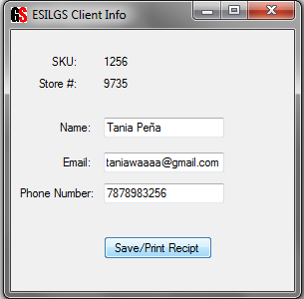
User Interfaces
Client Info
Victor

Slide 9
Logical Database Requirements
Frequency of database expected to be frequently
Live updated
Data must be verified weekly
Yanilette

Slide 10
Username
Password
Obtain Information of
Obtain Information of
Employee
GSSDBMS
GSGDBM
Access
Information
Local Search
External Search
Yanilette

Slide 11
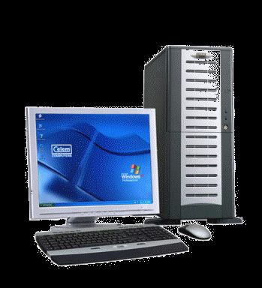
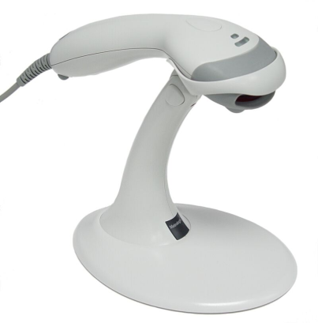
Hardware Interfaces
Standard Workstation:
Monitor, CPU, Mouse, Keyboard
DSL/Cable Router
Printer & Scanner
Tania

Slide 12


Software Interfaces
ES DBMS is an extension of the GameStop POS
GameStop POS is a customized version of Windows XP
Operating System includes integrated browser
Tania

Slide 13
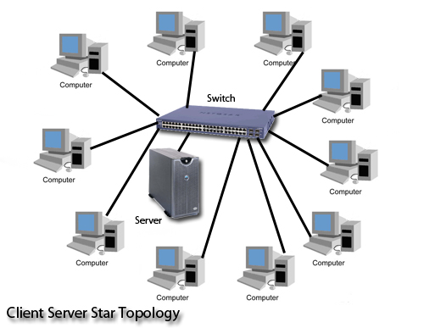
Communication Interfaces
TCP/ IP Protocols (Internet Protocol Suite)
Hypertext Transfer Protocol
Server communications
Tania

Slide 14
User Cases
The employee needs to enter the credentials ( username and password) to Access the ESILGS like is shown in Figure 2.2.1. If the user or password or both are invalid the employee can login to ESILGS.
Yanilette

Slide 15
User Cases
In Figure 2.2.2 For a Local Search the employee enter the Item information then look for the List of games to see if is available
Yanilette

Slide 16
User Cases
In figure 2.2.3 the Employee Select the Item then Enter the Zip Code and the Stores will be Display depending of the Zip Code entered. Then the employee select the store and select Processing and automatically the system send a confirmation to the Other store
Yanilette

Slide 17
User Characteristic
Basic Computer Skills
Bilingual
Consoles, games rating and accessories
Other requirements
Tania

Slide 18
Constraints
3.5.4 Software Restrictions:
OS: GS Authorized Customized Windows XP with Integrated Point of Sale Software.
Web browser: Customized Internet Explorer Browser embedded inside the proprietary OS.
3.5.5 Programming languages:
PHP (ver. 4.3 or higher)
JavaScript Library (to work with jQuery)
jQuery
Document Information: Cascading Style Sheets
Encoding: utf-8
Server: Header: Microsoft-IIS/6.0
Jonathan

Slide 19
Constraints
3.5.1 Hardware restrictions:
The computers provided by the company are compatible with the program since ESDBMS is an optimization of the currently established Item Lookup.
3.5.2 User system requirements:
Processor: 233 GHz
Memory: 4 GB RAM
3.5.3 Server requirements:
Microsoft-IIS/6.0
Processor: 8 core processor (3.6 GHz)/Server
Memory minimum: 16 GB of RAM/Server
Most-Cost Efficient amount of memory: 32 GB of RAM/Server
Memory max: 64 GB of RAM/Server
Jonathan

Slide 20
Constraints
3.5.6 Standards Compliance
ESDBMS is an extension of the main system that GS utilizes so as such it does not deal with data altering, report generating or deal with accounting. It uses the user and password securities to keep a log of the hold/requests and orders placed in order to follow up on them, but any payment/customer information is not stored or can be added inside the ESDBMS extension. The log in software is only present when the program is initiated and belongs to the main system
Jonathan

Slide 21
Software System Attributes
Reliability
Proper Internet Connection
Update
System dropping
Security
System requirements for security
Authentication
Area for the system
Tania

Slide 22
Assumptions
Employee has an account to access the ESILGS.
ESILGS is installed in the Operating Systems Windows.
ESILGS is connected to GSSDBMS when the Employee performed a local Search.
ESILGS is connected to GSGDBMS when the Employee performed an External Search.
Tania

Slide 23
Dependencies
Every employee needs an account (username, password) to access ESILGS.
The ESILGS have to be installed on Windows XP, Windows Vista or Window 7.
ESILGS doesn’t work on Linux or Mac OS.
Tania

Slide 24
Future Features
ESILGS will be able for the public on the internet so people could be able to buy and hold products, then just go to the store to pick up the product.
Victor

Slide 25
Team Member | Work Load | Total Hours
Yanilette López Duprey | Definitions, Acronyms, Abbreviations System Interfaces Product functions User Cases diagrams Assumptions and Dependencies Apportioning of Requirements Functional Requirements SRS Organization | 25.30 hrs / $20 per hrs = $506.00
Tania Peña Santana | Purpose-created/update User Characteristics-created/update Product functions Software System Attributes-created/update Acronyms and words meaning update | 21 hrs / $20 per hrs = $420
Victor Rivera Diaz | Scope Product functions Constraints External Interfaces User Interfaces Figures SDD | 20 Hrs / 20 per hrs = $400

Slide 26
Team Member | Work Load | Pay Hours
Nilka Quiles González | Overview User Interfaces Product functions Logical database requirements | 13 Hrs / $20 per hrs = $260
Jonathan Meléndez Brady | SPMP STD Product Perspective Hardware Interfaces Software Interfaces Communication Interfaces Memory Constraints Site Adaption Requirements Performance Requirements Design Constraints | 19 hrs / $20 per hrs = $380

Slide 27
Resource Allocation
Resource | Amount
Logbook + Pen | $43.85
Food | $150
Gasoline | $200
Total | $393.85

Slide 28
Schedule
Work Packages | Date Began / Date Due
SRS First Version | 08/15/2011 – 09/20/2011
SRS Revised | 09/21/2011 – 11/03/2011
SDD | 09/21/2011 – 11/03/2011
STD | 09/21/2011 – 11/03/2011
SPMP | 08/15/2011 – 11/03/2011
PowerPoint Presentation | 10/30/2011 – 11/03/2011

Slide 29
END

